Slide 1
recommendation sYSTEM
Gigi Ghvinjilia
Giorgi kamkamidze

Slide 2
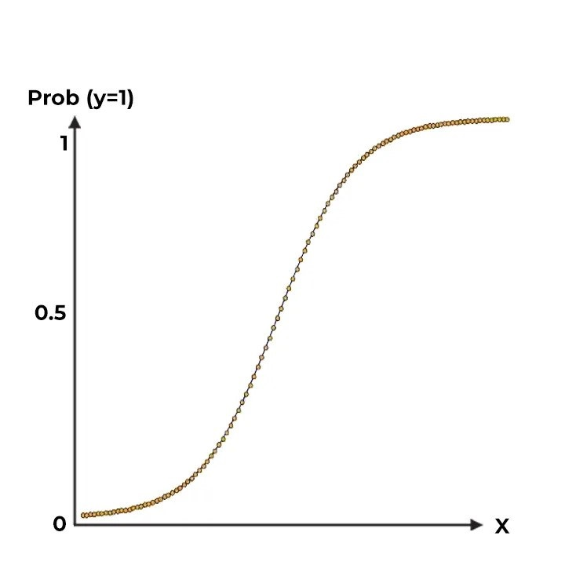
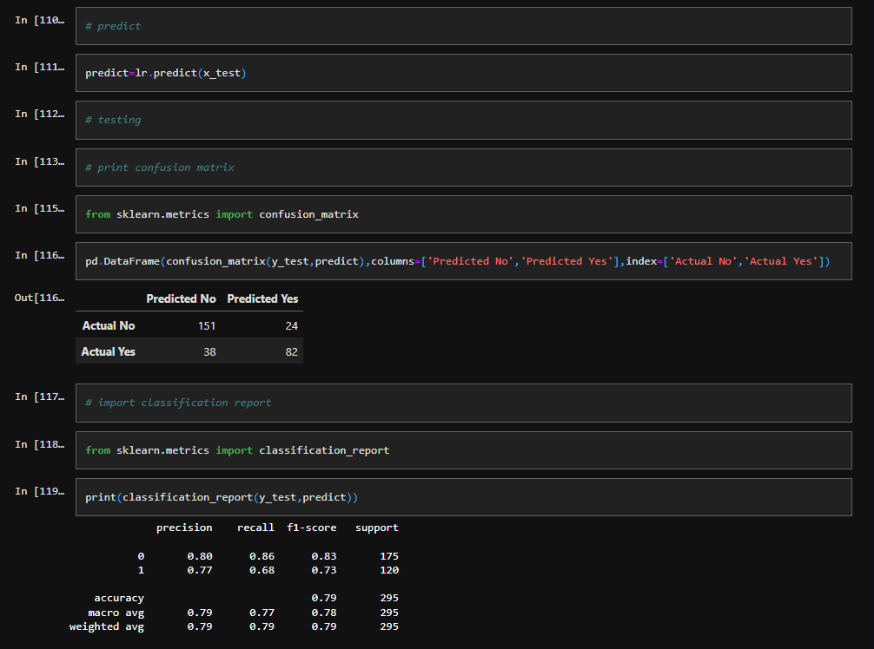
My First project (Logistic Regression)

Slide 3
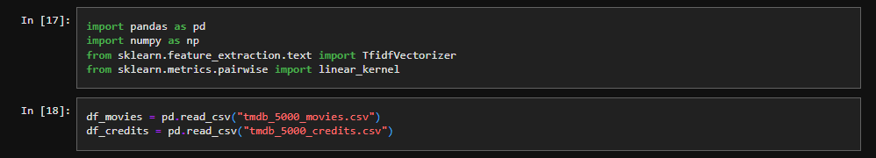
Importing modules and csv files
Download data from any sites you want (I used Kaggle).
I used csv files with information of movies and credits

Slide 4
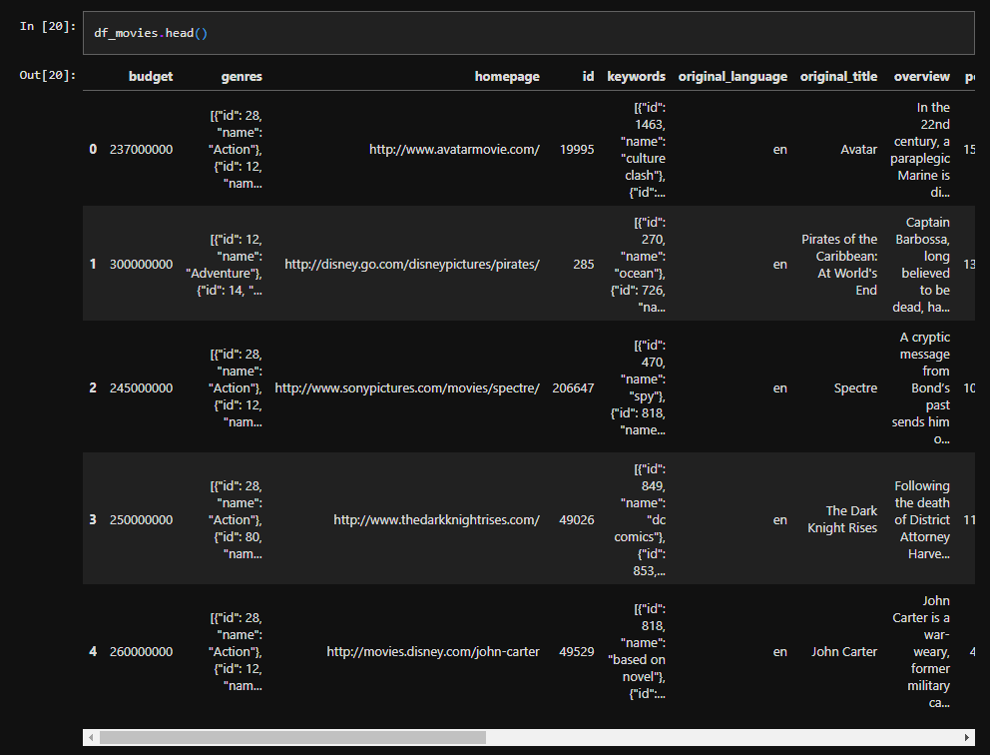
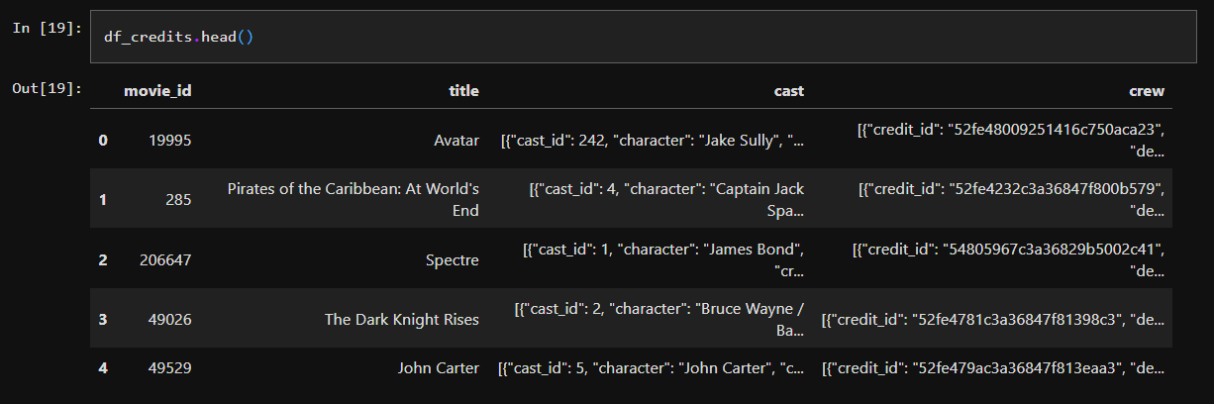
Lets see the content of our csv files
pandas module.
We can see first top 5 lines of csv file
by using --- head()

Slide 5
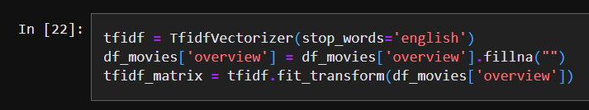
Cleaning data and Vector space model
tfidf = TfidfVectorizer(stop_words='english’)
This command will ignore words like --- (“but”, “a”, “the”…)
In second line we are filling all NA info with empty string
Last line builds basic tfidf matrix (vsm)

Slide 6
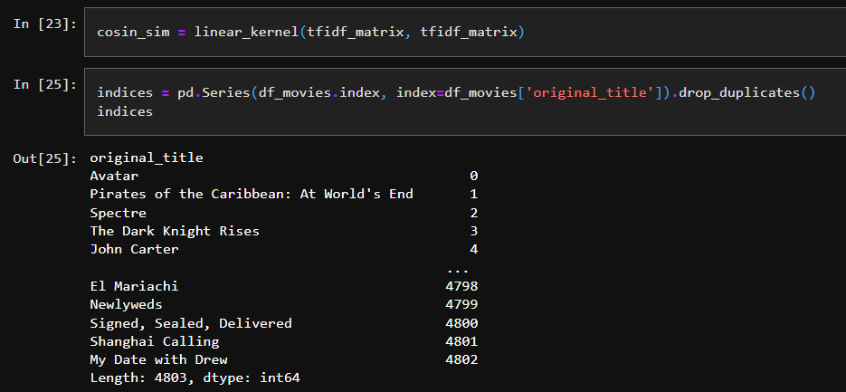
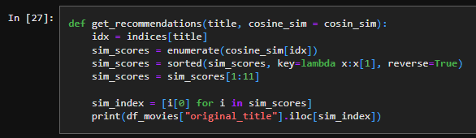
Cosine similarity, indexes and basic algorithm
Algorithm takes title and cosine similarity,
Then we extract index of a movies.
After that we need to get cosine_sim with respect of idx. sorte it and print.

Slide 7
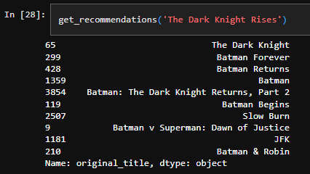
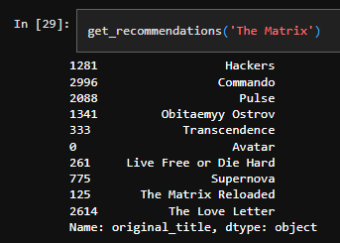
The end
results

